Slide 1

Chapter 15
Advanced Normalization

Slide 2

Chapter 15 - Objectives
Normal forms that go beyond Third Normal Form (3NF), which includes Boyce-Codd Normal Form (BCNF), Fourth Normal Form (4NF), and Fifth Normal Form (5NF).
How to identify Boyce–Codd Normal Form (BCNF).
How to represent attributes shown on a report as BCNF relations using normalization.

Slide 3
Chapter 15 - Objectives
Concept of multi-valued dependencies and Fourth Normal Form (4NF).
The problems associated with relations that break the rules of 4NF.
How to create 4NF relations from a relation, which breaks the rules of to 4NF.

Slide 4

Boyce–Codd Normal Form (BCNF)
Based on functional dependencies that take into account all candidate keys in a relation, however BCNF also has additional constraints compared with the general definition of 3NF.
Boyce–Codd normal form (BCNF)
  A relation is in BCNF if and only if every determinant is a candidate key.

Slide 5
Boyce–Codd Normal Form (BCNF)
Difference between 3NF and BCNF is that for a functional dependency A → B, 3NF allows this dependency in a relation if B is a primary-key attribute and A is not a candidate key. Whereas, BCNF insists that for this dependency to remain in a relation, A must be a candidate key.
Every relation in BCNF is also in 3NF. However, a relation in 3NF is not necessarily in BCNF.

Slide 6
Boyce–Codd Normal Form (BCNF)
Violation of BCNF is quite rare.
The potential to violate BCNF may occur in a relation that:
  contains two (or more) composite candidate keys;
  the candidate keys overlap, that is have at least one attribute in common.

Slide 7

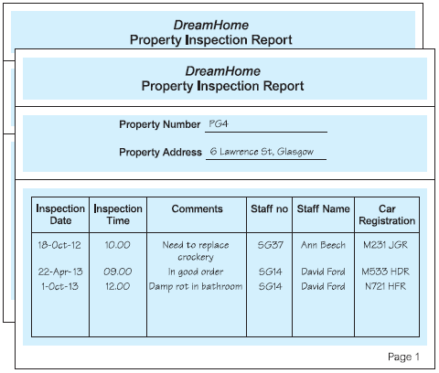
Review of Normalization (UNF to BCNF)

Slide 8
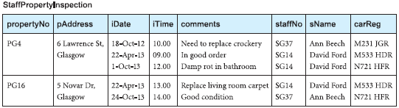
Review of Normalization (UNF to BCNF)
StaffProperyInspection in UNF
  Must handle multi-valued attribute to get to 1NF

Slide 9
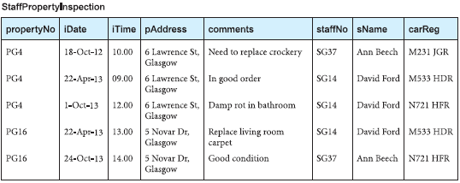
Review of Normalization (UNF to BCNF)
StaffPropertyInspection in 1NF
  2 tuples -> 5 tuples

Slide 10
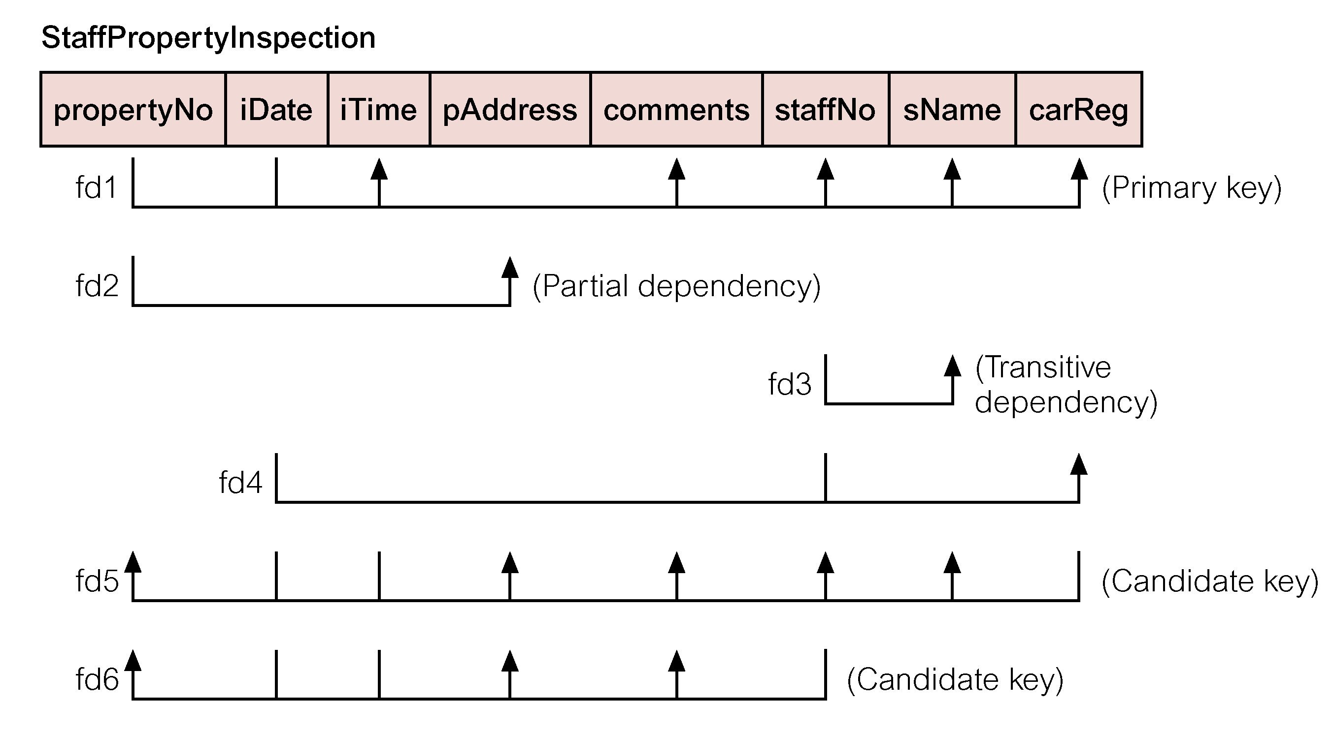
Identify all Functional Dependencies in 1NF version

Slide 11
1NF -> 2NF
1NF
  StaffPropertyInspection (propertyNo, iDate, iTime, pAddress, comments, staffNo, sName, carReg)
  Primary key: propertyNo, iDate
  Functional dependencies fd1 to fd6 (see previous slide)
1NF -> 2NF
  Remove partial fd (fd2): propertyNo -> pAddress
  Create 2 tables from StaffPropertyInspection
      PropertyInspection & Property

Slide 12
2NF -> 3NF
2NF
  PropertyInspection (propertyNo, iDate, iTime, comments, staffNo, sName, carReg)
  Property (propertyNo, pAddress)
2NF -> 3NF
  Remove transitive fd (fd3) from PropertyInspection
  fd1 propertyNo, iDate -> … staffNo..
  fd3 staffNo-> sName
  Create 2 tables from PropertyInspection
    PropertyInspect & Staff

Slide 13
3NF Schema
PropertyInspect (propertyNo, iDate, iTime, comments, staffNo, carReg)
  fd1’ propertyNo, iDate -> iTime, comments, staffNo, sName, carReg
  fd4 staffNo, iDate -> carReg
  fd5’ carReg, iDate, iTime -> propertyNo, commends, staffNo
  fd6’ staffNo, iDate, iTime -> propertyNo, comments
Property (propertyNo, pAddress)
  fd2 propertyNo -> pAddress
Staff (staffNo, sName)
  fd3 staffNo -> sName

Slide 14
3NF -> BCNF
All determinants (lhs) must be candidate keys
Staff and Property in BCNF
PropertyInspect: not in BCNF
  fd4 staffNo, iDate -> carReg
    Staff assigned same car for the whole day
  staffNo, iDate is not a candidate key for PropertyInspect
    Staff could inspect >1 properties on the same day (domain knowledge)
Create two new relations from PropertyInspect
  Inspection (propertyNo, iDate, iTime, comments, staffNo)
  StaffCar (staffNo iDate, carReg)

Slide 15
BCNF Schema
Inspection (propertyNo, iDate, iTime, comments, staffNo)
  fd1’’ propertyNo, iDate -> iTime, comments, staffNo, sName
  fd5’’ iDate, iTime -> propertyNo, comments, staffNo
  fd6’ staffNo, iDate, iTime -> propertyNo, comments
Property (propertyNo, pAddress)
  fd2 propertyNo -> pAddress
Staff (staffNo, sName)
  fd3 staffNo -> sName
StaffCarReg (staffNo, iDate, carReg)
  fd4 staffNo, iDate -> carReg

Slide 16
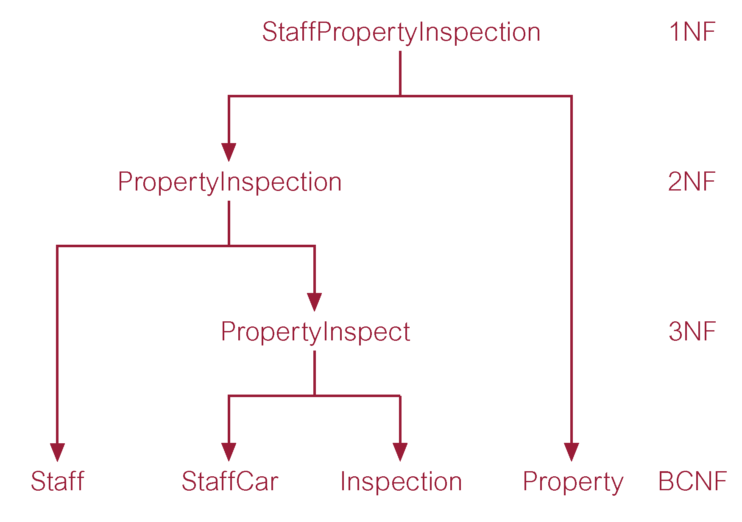
Review of Normalization (1NF to BCNF)

Slide 17
Fourth Normal Form (4NF)
Multi-valued Dependency (MVD)
  Dependency between attributes (for example, A, B, and C) in a relation, such that for each value of A there is a set of values for B and a set of values for C. However, the set of values for B and C are independent of each other.
Defined as a relation that is in Boyce-Codd Normal Form and contains no nontrivial multi-valued dependencies.

Slide 18
Fourth Normal Form (4NF)
MVD between attributes A, B, and C in a relation using the following notation:
A −>> B
A −>> C

Slide 19
Example
BranchStaffOwner
  Has two independent, mulivalued dependencies in same table:
    branchNo ->> sName (branches have multiple staff)
    branchNo ->> oName (branches have multiple properties which may have different owners)
  End up having to duplicate tuples to show each staff member with each owner
    E.g., add a new staff member, have to add 2 new tuples, one for each oName
Solution: make a separate relation for each dependency

Slide 20
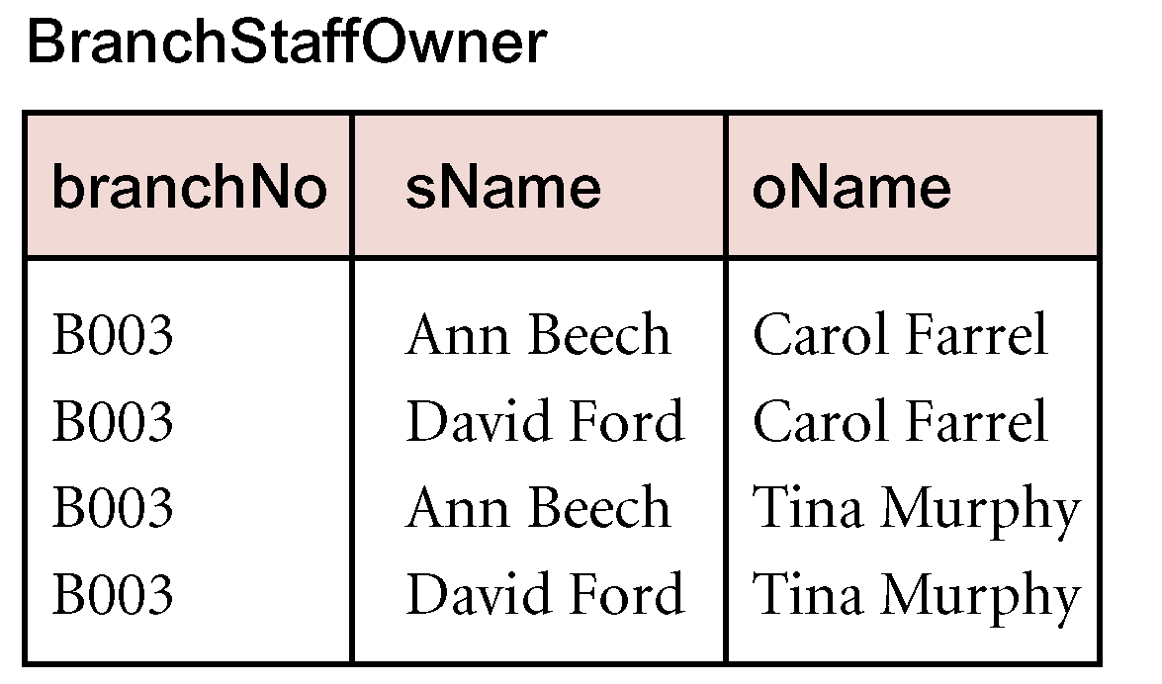
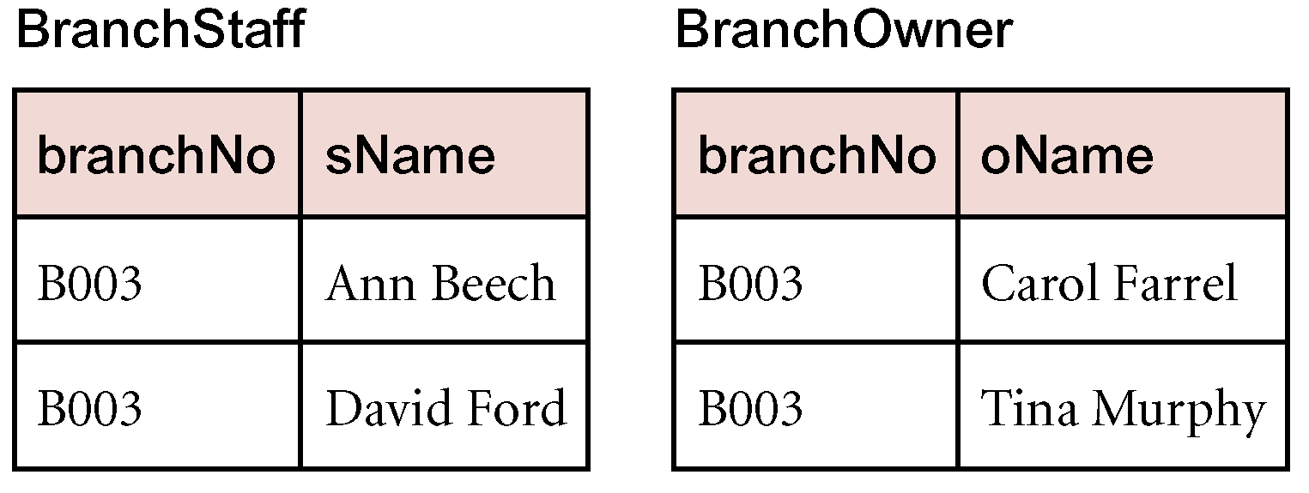
4NF - Example

Slide 21
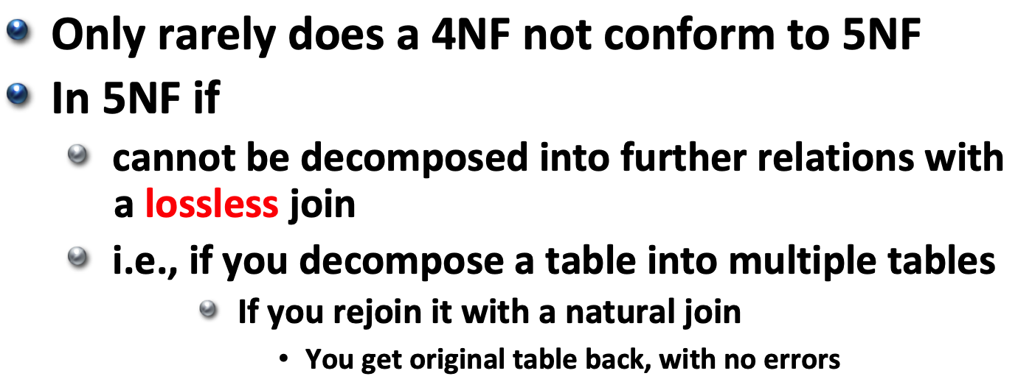
Fifth Normal Form (5NF)

Slide 22
Fifth Normal Form (5NF)
In other words, in 5NF, all relations are decomposed into as many relations as possible without introducing errors
  All tables are key, and attributes that depend on key; no other fd

Slide 23
5NF
Do NOT decompose tables if all attributes depend on same key
  E.g., <SSN, Name, Birthdate, Zip> stays in one table
  Do not decompose into
    <SSN, Name>
    <SSN, Birthdate>
    <SSN, Zip>

Slide 24
5NF – Example (table is in 4NF)
Traveling Salesman | Brand | Product Type
Jack Schneider | Acme | Vacuum Cleaner
Jack Schneider | Acme | Breadbox
Mary Jones | Robusto | Pruning Shears
Mary Jones | Robusto | Vacuum Cleaner
Mary Jones | Robusto | Breadbox
Mary Jones | Robusto | Umbrella Stand
Louis Ferguson | Robusto | Vacuum Cleaner
Louis Ferguson | Robusto | Telescope
Louis Ferguson | Acme | Vacuum Cleaner
Louis Ferguson | Acme | Lava Lamp
Louis Ferguson | Nimbus | Tie Rack

Slide 25
5NF - Example
Primary Key: Composite of all three attributes (Traveling Salesman, Brand, Product Type)
In 4NF
Suppose there is a rule that, if a salesman offers the same product from TWO different Brands
  Then he must offer all other products from those brands IF he sells those products at all

Slide 26
5NF - Example
So, If Jack Schneider starts to sell Robusto’s Vacuum Cleaners
  He must also now sell Robusto’s Breadboxes, too, because he sells Breadboxes
    But, he doesn’t sell Pruning Shears or Umbrella Stands (from Robusto) or Lava Lamps (from Acme)
      That’s okay
  If not in 5NF,
    Need logic in the insert function to enforce rules
    Add 2 tuples
      <Jack Schneider, Robusto, Vacuum Cleaner>
      <Jack Schneider, Robusto, Breadbox>
    Possibility of update/insert/deletion errors

Slide 27
5NF - Example
Instead, decompose into 3 relations:
  Traveling Salesman -> Product Type
  Traveling Salesman -> Brand
  Brand -> Product Type
Now, table design excludes possibility of inconsistencies
  He starts selling Robusto Vaccuum cleaners
  Add <Jack Schneider, Robusto> to TravellingSalesman+Brand table
  Captures that he sells Breadboxes and Vacuum Cleaners from Robusto and Acme

Slide 28
5NF - Example
Traveling Salesman | Brand
Jack Schneider | Acme
Mary Jones | Robusto
Louis Ferguson | Robusto
Louis Ferguson | Acme
Louis Ferguson | Nimbus
Traveling Salesman | Product Type
Jack Schneider | Vacuum Cleaner
Jack Schneider | Breadbox
Mary Jones | Pruning Shears
Mary Jones | Vacuum Cleaner
Mary Jones | Breadbox
Mary Jones | Umbrella Stand
Louis Ferguson | Vacuum Cleaner
Louis Ferguson | Telescope
Louis Ferguson | Lava Lamp
Louis Ferguson | Tie Rack
Brand | Product Type
Acme | Vacuum Cleaner
Acme | Breadbox
Acme | Lava Lamp
Robusto | Pruning Shears
Robusto | Vacuum Cleaner
Robusto | Breadbox
Robusto | Umbrella Stand
Robusto | Telescope
Nimbus | Tie Rack

Slide 29
5NF - Example
Need to join all 3 relations to get original relation
  Can get spurious tuples by just joining two relations
    E.g., join <Jack Schneider, Acme> with <Acme, Lava Lamp>
      Conclude that Jack sells Acme Lava Lamps and he doesn’t
  Must join with all 3 relations
    <Jack Schneider, Acme> with
    <Jack Schneider, Vacuum Cleaner> AND <Jack Schneider, Breadbox> with
    <Acme, Vacuum Cleaner> <Acme, Breadbox> <Acme, Lava Lamp>

Slide 30
Normalization Summary
As we normalize, we change schema to contain more and more tables with fewer and fewer attributes in each table
  Reduces redundancy
  BUT need to do joins to answer queries
    E.g., can get sName for a given date, time an property from StaffPropertyInspection (2NF)
    Need to join PropertyInspect and Staff on staffNo to get the name in 3NF
Classic time/space trade-off in CS

Slide 31
Normalization Summary
If you do an object-oriented design of your database, you will be generally be in 4NF
  E.g., classes (relations) for: property, staff, owners, cars, etc…
  Attributes for each class in the relation for that class

